Slide 1

Lecture 09: Propositional Logic, II
Artificial Intelligence (CS 131)

Slide 2
Logic in the Wumpus World
We can use PL to express the situation of the agent:
Let P_{i,j} be true if there is a pit in location [i, j]
Let B_{i,j} be true if there is a breeze in location [i, j]
The relevant KB is:
PL can also express Wumpus World rules like “Pits cause breezes in adjacent squares”:
?
?
B
?
A
OK
OK
A
: Agent
: Breeze
B

Slide 3
Inference in the Wumpus World
Based upon the knowledge base of basic propositional facts, and logical rules about how the world functions, we want to infer new knowledge about that world:
B
A
OK
OK
A
: Agent
: Breeze
B

Slide 4
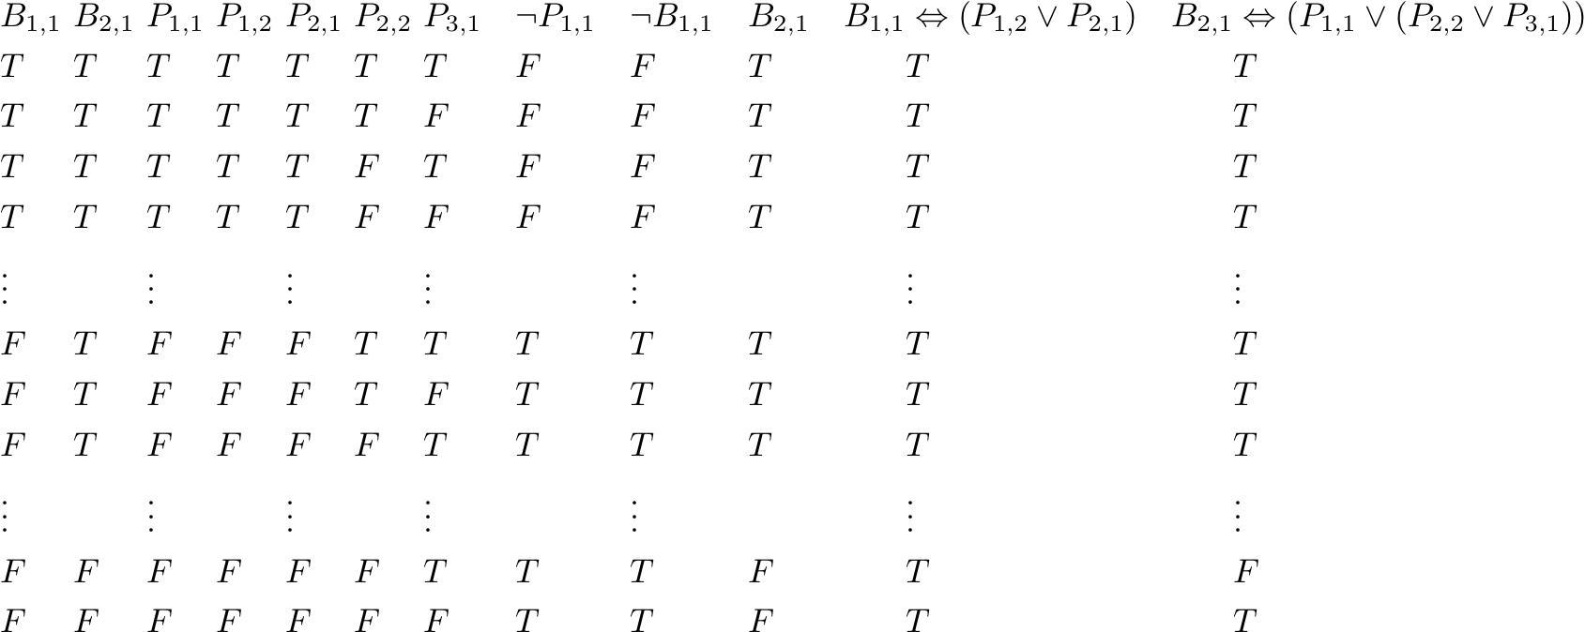
Inference Using Truth-Tables
Proposition Symbols
Sentences in the Knowledge Base
We can use the full set of possible truth-values to check whether a sentence α is entailed by our knowledge base

Slide 5
Inference Using Truth-Tables
Proposition Symbols
Sentences in the Knowledge Base
Given the full set of truth values, we consider models/assignments for which everything we know already is true

Slide 6
Inference Using Truth-Tables
Proposition Symbols
Sentences in the Knowledge Base
Now, we can see that there cannot be a Pit at location (1,2), since that sentence is false in every model consistent with what we already know

Slide 7
Inference Using Truth-Tables
Proposition Symbols
Sentences in the Knowledge Base
Similarly, we can see that there is a Pit either at (2,2) or (3,1), but we don’t know which, since either one could be false (although not both)

Slide 8
Inference Techniques
Inference is the procedure of deriving (i.e., generating) new sentences based on our existing knowledge base
Procedure P is sound if it only ever leads to sentences that are entailed by the knowledge base:
Procedure P is complete if it can generate all sentences that are entailed by the knowledge base:

Slide 9
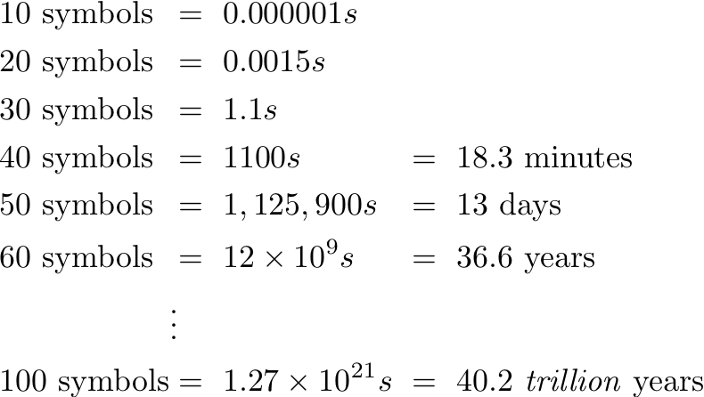
Effective Inference Procedures
Enumerating all truth tables to derive new sentences can be automated (algorithm: Figure 7.10, page 221 of R&N text)
This procedure is sound and complete; however, it is ineffective due to complexity:
For n propositional symbols, the full truth-table has 2^{n} rows
If it took only a nanosecond to check each row, then checking:
For Breeze and Pit only, (4 × 4) Wumpus World has 32 symbols
For Breeze, Stench, Glitter, Pit, Gold, Wumpus, we already get 96!

Slide 10
A Special Case: Definite/Horn Form
In some cases, we can represent KB in a special restricted PL syntax
A definite clause α is either (1) a literal: either P_{i} or ¬P_{i} , for some propositional symbol P_{i} , or (2) a sentence of the special form:
Definite clauses are equivalent to disjunctions with exactly one positive symbol
A slightly more relaxed definition: Horn clause, which has at most one positive symbol; both of the following are Horn clauses, but only the first is definite
Tail
Head

Slide 11
A Special Case: Definite/Horn Form
If our knowledge base is made up only of definite clauses, then we can repeatedly apply the rule of Modus Ponens (MP):
This can be written in disjunctive form as well:
This rule gives us a sound and complete inference procedure that can be employed in simple linear-time algorithms

Slide 12
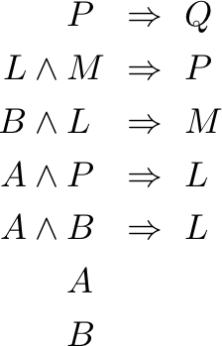
Forward Chaining with Definite KBs
When we have a set of definite clauses, we can represent the structure of our knowledge base graphically
Q
KB
P
M
L
A
B

Slide 13
Forward Chaining with Definite KBs
Image source: Russell & Norvig (2021)
For definite clauses that are equivalent to conditionals, count how many propositions make up its tail
For example, the following clause has count = 3:

Slide 14
Forward Chaining with Definite KBs
Premise elimination: if we see part of the tail, decrement count
Modus Ponens: if we have seen all parts of tail, infer head

Slide 15
Backwards Chaining
A similar algorithm works backward from the thing we want to prove, q, checking if it is already in KB
If not, then we check for a Horn clause that has q as its head
If so, we repeat the process for all premises in the tail
Terminate (and fail) if any premise can’t be proved, else succeed
Both FC and BC are linear-time algorithms:
By keeping track of whether we have used a premise before (either to “fire” a clause in FC or as an object of proof in BC), we visit each propositional symbol at most once
For n sentences in our KB, the algorithms run in O(n)
BC can often do even better, avoiding unnecessary work

Slide 16
Forward Chaining with Definite KBs, 01
Initial count set to # premises in tail of conditionals
1
Q
KB
2
P
M
2
L
2
queue : basic propositions already known
2
A
B

Slide 17
Forward Chaining with Definite KBs, 02
Suppose we are trying to infer Q : we begin to “fire” clauses using Modus Ponens rules, decrementing count
1
Q
KB
query : Q
2
P
M
2
L
2
2
A
B

Slide 18
Forward Chaining with Definite KBs, 03
Known facts in the queue lead to decremented count
1
Q
KB
query : Q
2
P
M
1
L
1
0
A
B

Slide 19
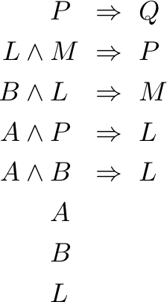
Forward Chaining with Definite KBs, 04
Whenever count reaches 0, we add the associated head of the conditional to the queue
1
Q
KB
query : Q
2
P
M
1
L
1
0
A
B

Slide 20
Forward Chaining with Definite KBs, 05
We repeat the process so long as something is in the queue, and we have not yet arrived at our query
1
Q
KB
query : Q
1
P
M
1
L
0
0
A
B

Slide 21
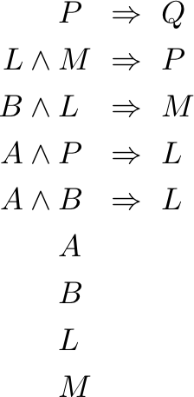
Forward Chaining with Definite KBs, 06
We repeat the process so long as something is in the queue, and we have not yet arrived at our query
1
Q
KB
query : Q
1
P
M
1
L
0
0
A
B

Slide 22
Forward Chaining with Definite KBs, 07
We repeat the process so long as something is in the queue, and we have not yet arrived at our query
1
Q
KB
query : Q
0
P
M
1
L
0
0
A
B

Slide 23
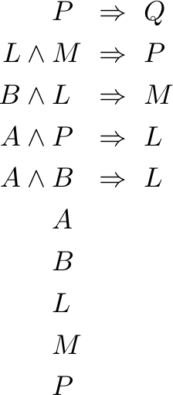
Forward Chaining with Definite KBs, 08
We repeat the process so long as something is in the queue, and we have not yet arrived at our query
1
Q
KB
query : Q
0
P
M
1
L
0
0
A
B

Slide 24
Forward Chaining with Definite KBs, 09
We repeat the process so long as something is in the queue, and we have not yet arrived at our query
0
Q
KB
query : Q
0
P
M
0
L
0
0
A
B

Slide 25
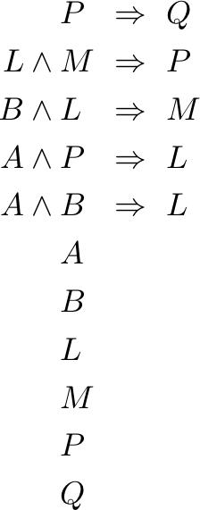
Forward Chaining with Definite KBs, 10
We conclude when either every count is 0, or query is in the queue
0
Q
KB
query : Q
0
P
M
0
L
0
0
A
B
SUCCESS

Slide 26
A General Algorithm: Resolution
While definite/Horn clauses cannot express everything in PL, we can put any sentence into Conjunctive Normal Form (CNF): a conjunction where each clause is a disjunction of positive/negative literals, e.g.:
For disjunctive clauses, resolution is a sound & complete inference rule:
where l_{i} and m_{j} are complementary—i.e., one is the negation of the other:

Slide 27
Converting to CNF
Every sentence of PL can be written in CNF by a simple set of conversions. For example:

Slide 28
The Resolution Algorithm
Image source: Russell & Norvig (2021)
We can use repeated applications of resolution to show (KB ∧ ¬𝛼) is unsatisfiable, where 𝛼 is some query we are interested in (NB: negated)
If achieve empty set of clauses, this shows that the KB and the query ¬α cannot both be true at the same time; by definition, this means that KB entails α
A form of proof by contradiction
The basic resolution rule, applied as many times as appropriate
No entailment if we ever run out of new things to resolve

Slide 29
Using Resolution
Original KB
Negation of what we want to prove

Slide 30
Using Resolution
Resolution rule will not always be productive: it can sometimes generate consequences that are not really helpful to our proof:

Slide 31
Using Resolution
However, it will also eventually generate everything that is entailed by KB (a complete procedure):
Empty Clause: implies a contradiction (something cannot be satisfied), and so ¬P_{1,2} is entailed by KB

Slide 32
Resolution as an Algorithm
Resolution is a sound and complete inference method
However, while often effective, we must live with the fact that in the worst case it can run in exponential time
Given n propositional symbols, we may need 2^{n} applications of basic resolution rule to reach a stopping condition
This seems to be a necessary fact for any general-purpose PL inference procedure: it is well-known that the PL entailment/provability question is NP-complete

